Slide 1

Group No. 7 Topic - EDI
Nagindas Khandwala College Autonomous

Slide 2
Ayush Sanghavi -76
Melisha Cetty -73
Rajesh Rane -85
Kashinath Tawte -61
Dhaval Mali -77
Kaushik Yadav -74
Yash Pandey -38
Atul Pal -36
Sumedh Bhat -7
Sudhir Rapaka -47
Group
7
Members

Slide 3
Introduction
What is EDI?
How does EDI Works?
Benefits of EDI
EDI standards
Drawback of EDI

Slide 4
1. What is EDI?

Slide 5


Slide 6
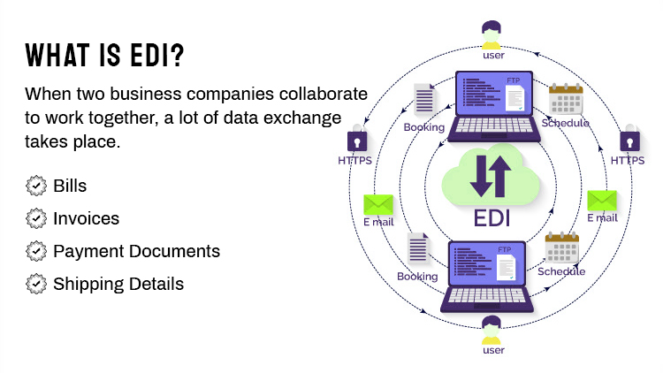
What is EDI?
“Electronic Data Interchange (EDI) is the computer-to-computer exchange of business documents in a standard electronic format between business partners.”

Slide 7
Four Types Of EDI
Computer-To-Computer
Business Doucment

Slide 8
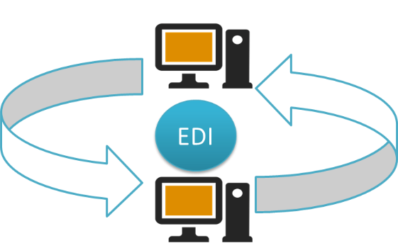
The EDI process looks like this – no paper, no people involved:

Slide 9
Business Partners
Standard Format

Slide 10
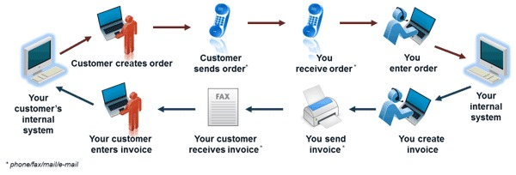
A typical manual process looks like this, with lots of paper and people involvement:

Slide 11
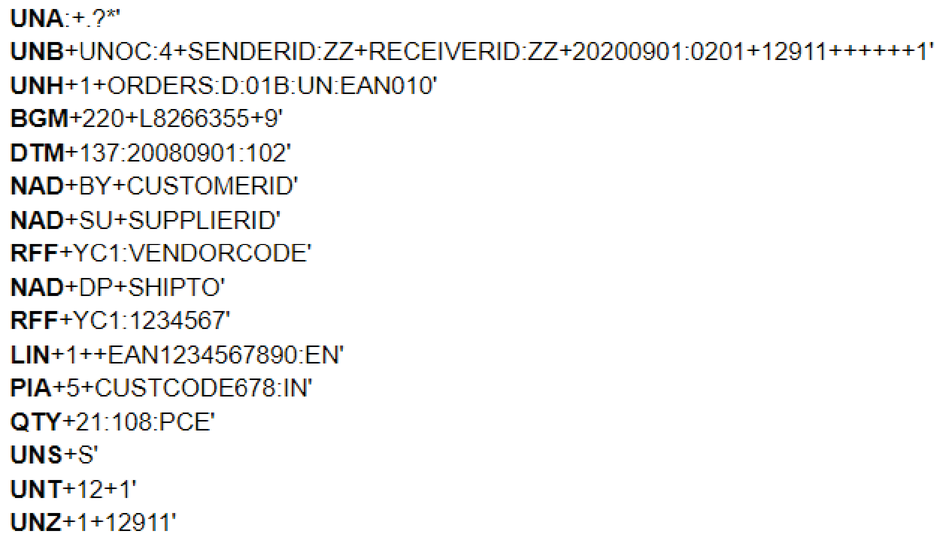
Example

Slide 12
2. How Does EDI Works

Slide 13
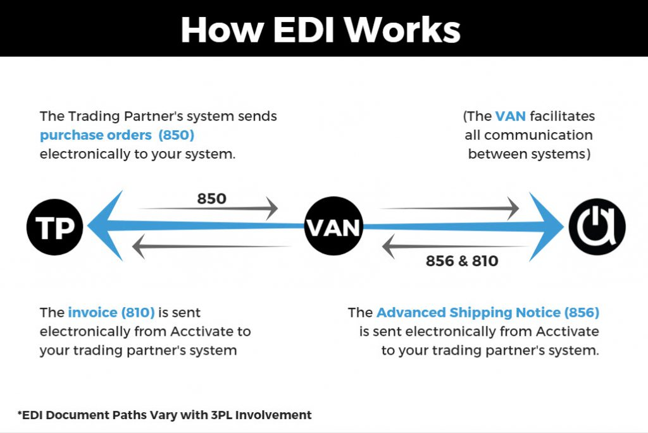
How Does EDI Work?
There are 3 steps to sending EDI documents – Prepare the documents, Translate the documents into EDI format, Transmit the EDI documents to your partner.

Slide 14
Four Steps for working in EDI Works
STEP1: PREPARE THE DOCUMENT TO BE SENT
01

Slide 15


Slide 16
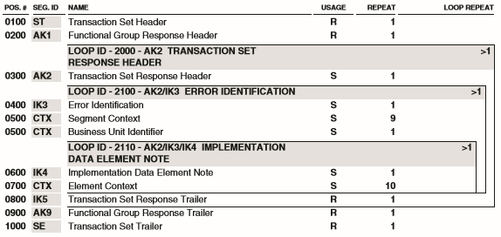
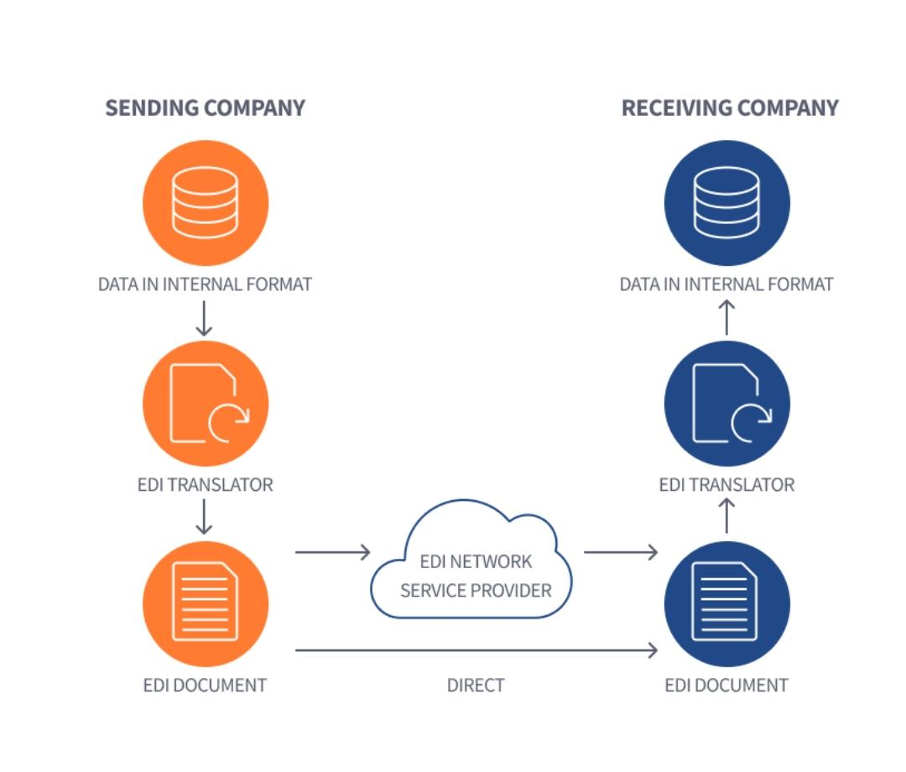
STEP2: TRANSALTE THE DOUCMENT INTO EDI FORMATE
02
STEP3: CONNECT AND TRANSMIT YOUR EDI DOCUMENT TO YOUR BUSINESS PARTNER
03

Slide 17
Example

Slide 18
3. Benefits Of EDI

Slide 19

Benefits Of EDI(Electronic Data Interchange)
EDI continues to prove its major business value by lowering costs, improving speed, accuracy and business efficiency. The greatest EDI benefits often come at the strategic business level.
EDI continues to prove its worth as an electronic message data format. This research states that “the annual volume of global EDI transactions exceeds 20 billion per year and is still growing.”
1 For buyers that handle numerous transactions, using EDI can result in millions of dollars of annual savings due to early payment discounts

Slide 20
EDI Cost Saving
EDI Improves Speed And Accuracy
01
02

Slide 21
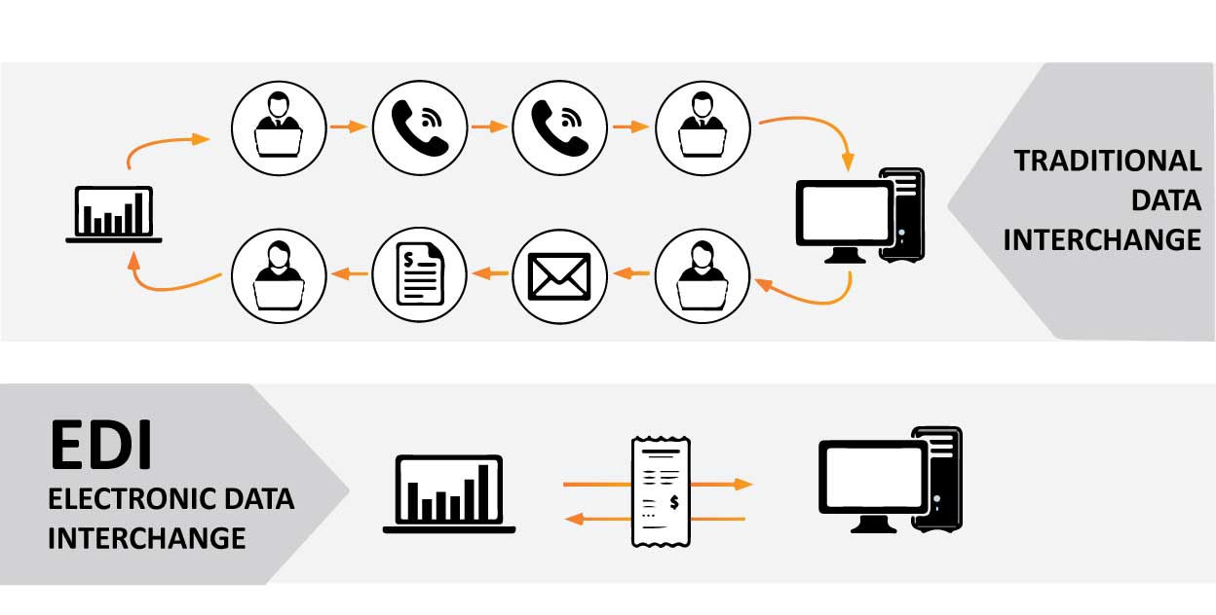

Slide 22
03
EDI’s Impact on Business Strategy
04
EDI’s Effect on Business Efficiency

Slide 23
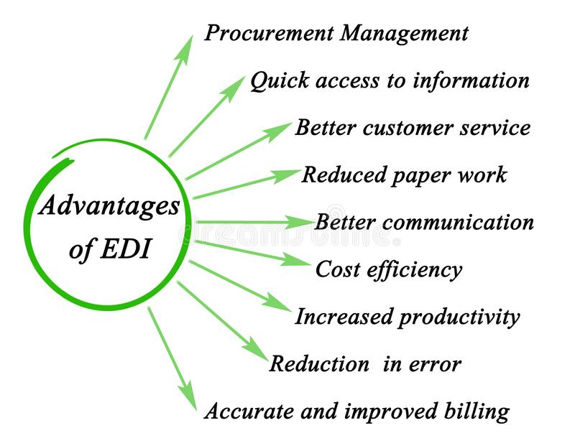

Slide 24
4. EDI Standards

Slide 25
EDI Standards
Technical basis for
automated commercial
01
Designed initially in
automotive industry
02
Same document found
in a Paper document
03

Slide 26


Slide 27
History
First appeared in the early to mid-1980’s
Prescribes mandatory and optional information for a particular document
The standards are like building codes.

Slide 28
Major Point Set Of EDI Standards
The UN-recommended UN/EDIFACT
The US standard ANSI ASC X12 (X12)
GS1 EDI set of standards developed the GS1
The TRADACOMS standard developed by the ANS
The ODETTE standard used within the European
The VDA standard used within European
HL7, a semantic interoperability,HIPAA.

Slide 29

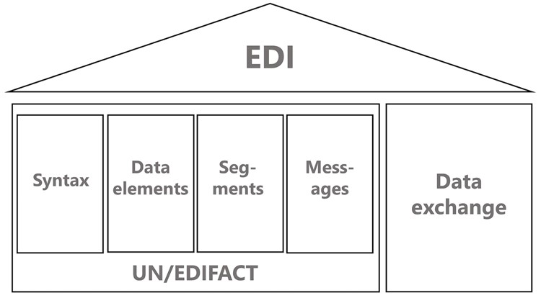


Slide 30
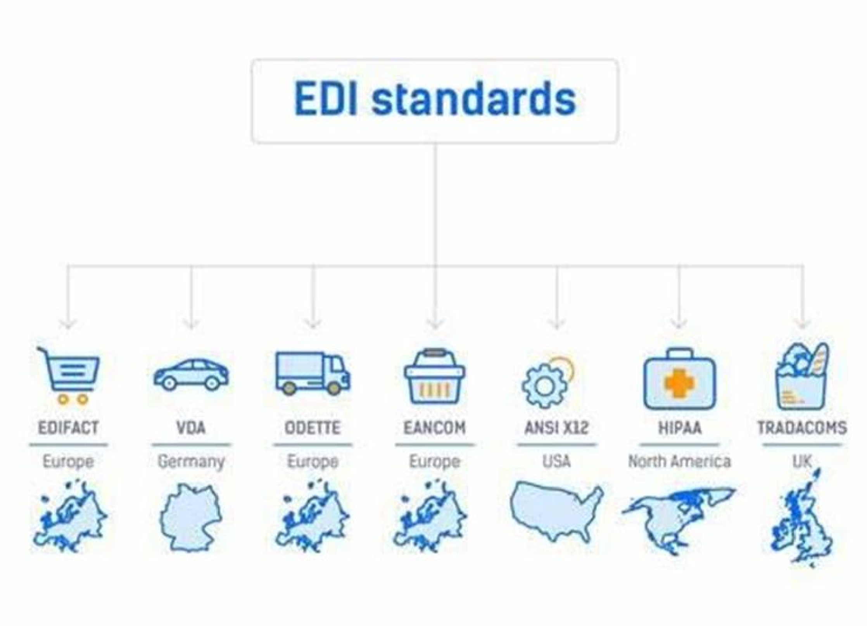
8) IATA Cargo-IMP
9) NCPDP SCRIPT
10) EDIGAS

Slide 31
5. Drawbacks Of EDI

Slide 32
Drawbacks Of EDI
Expensive
EDI Standard Changes
Initial setup is Time Consuming

Slide 33
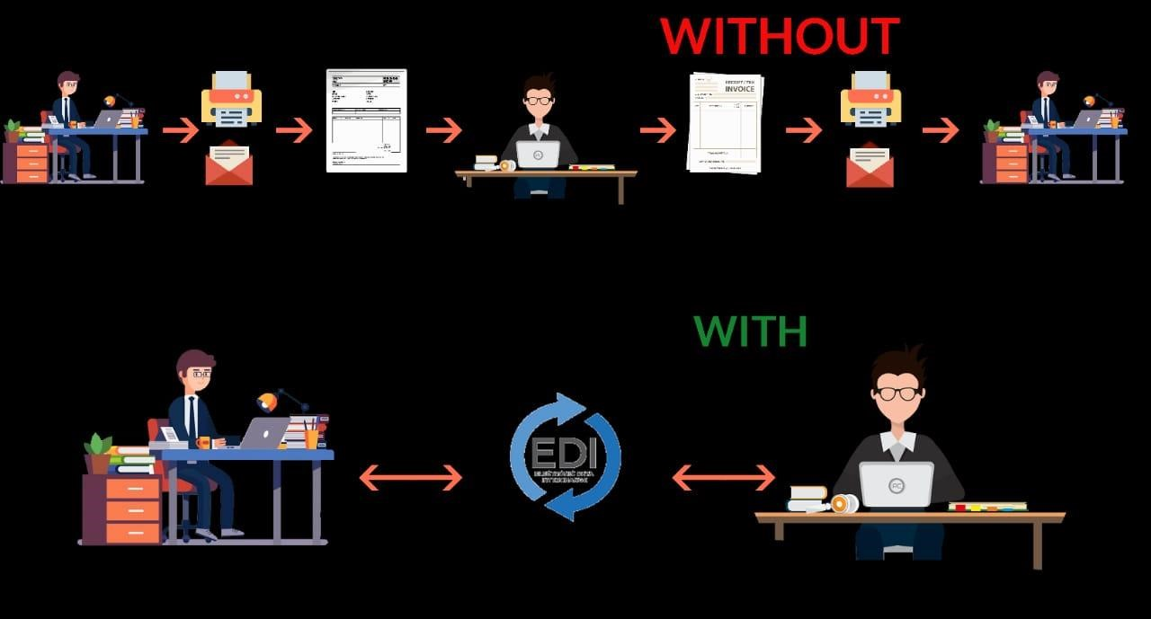

Slide 34

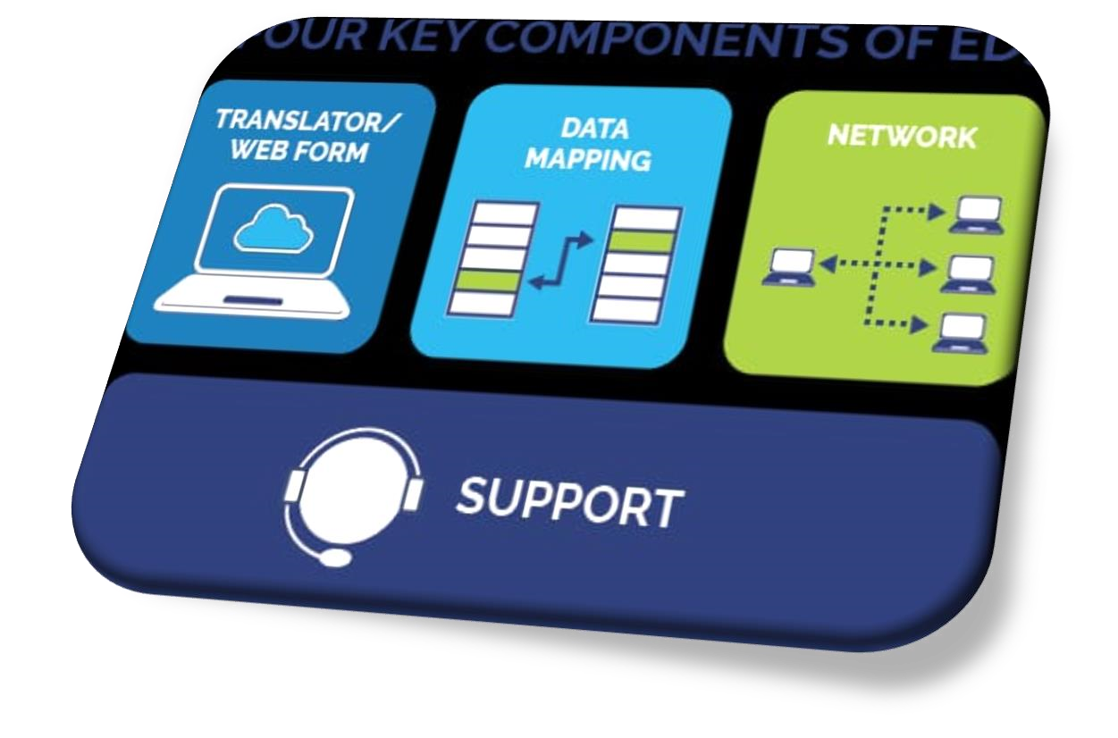
SYSTEM ELECTRONIC PROTECTION
PROPER BACKUP
1
3
.
STAFF TRAINING COST
LIMIT YOUR TRADING PARTNERS
2
4
START

Slide 35


